Slide 1
AI Agents for Digital Capability Building in Tata Steel
SUMMER INTERNSHIP - 2026
WEEK-2
AI Use Case Design + Experience Thinking
Under The Guidance of:
Mr. Abhinav Anish
Submitted By: Vaibhav Kumar

Slide 2
Problem Statement
Tata Steel employees across operations, maintenance, logistics, quality, and fabrication roles need continuous skill development to progress in their careers.
Current challenges include:
* Employees do not know which skills are required for their next role.
* Training recommendations are generic rather than personalized.
* Managers lack visibility into team skill gaps.
* Learning content is scattered across manuals, SOPs, and training documents.
* Employees spend significant time searching for information.
The objective is to build an AI-powered Learning & Development Assistant that provides personalized learning guidance, role progression support, and instant knowledge access.

Slide 3
Problem / Pain Point | Our Solution Feature
Employees don't know career progression path | AI Career Coach showing current role → target role → readiness score
Employees don't know what skills they lack | Skill Gap Analysis Engine comparing user skills with target role skills
Generic training recommendations | Personalized Course Recommendation Engine based on missing skills
Learning content scattered across manuals and PDFs | AI Knowledge Assistant (RAG) over SOPs, HR policies, safety manuals, NSDC role documents
Employees spend time searching documents | Natural Language Query Interface ("What is chemical spill procedure?")
Managers lack visibility into team learning | Manager Dashboard with team completion, readiness and top skill gaps
Executives lack department-level insights | Executive Dashboard with department analytics and manager comparison
L&D team cannot identify organization-wide skill gaps | L&D Analytics Dashboard showing top skill gaps, course adoption and readiness
Training not aligned with career goals | Role-Based Learning Paths mapped to Tata Steel job roles and NSQF levels
Employees struggle to understand training content | Multilingual Support (If Possible)

Slide 4
Expected Features
Employee Portal
Profile Career Progression Skill Gap Analysis Learning Recommendations AI Assistant Learning Progress
Executive Portal
Department Analytics Manager Comparison Department Readiness Skill Gap Trends
AI Assistant
Career Coach Skill Recommender Knowledge Assistant Learning Navigator
This is much stronger than just saying:
AI Coach AI Trainer Knowledge Assistant
L&D Portal
Organization Analytics Course Effectiveness Skill Gap Intelligence Training Planning
Manager Portal
Team Dashboard Skill Gap Monitoring Readiness Tracking Training Progress Monitoring

Slide 5
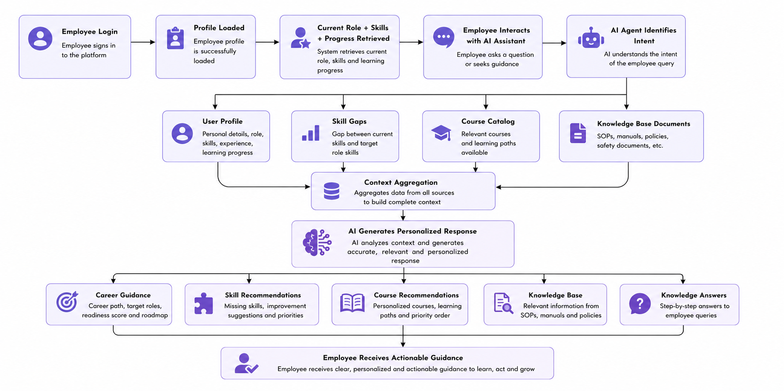
Complete Design

Slide 6
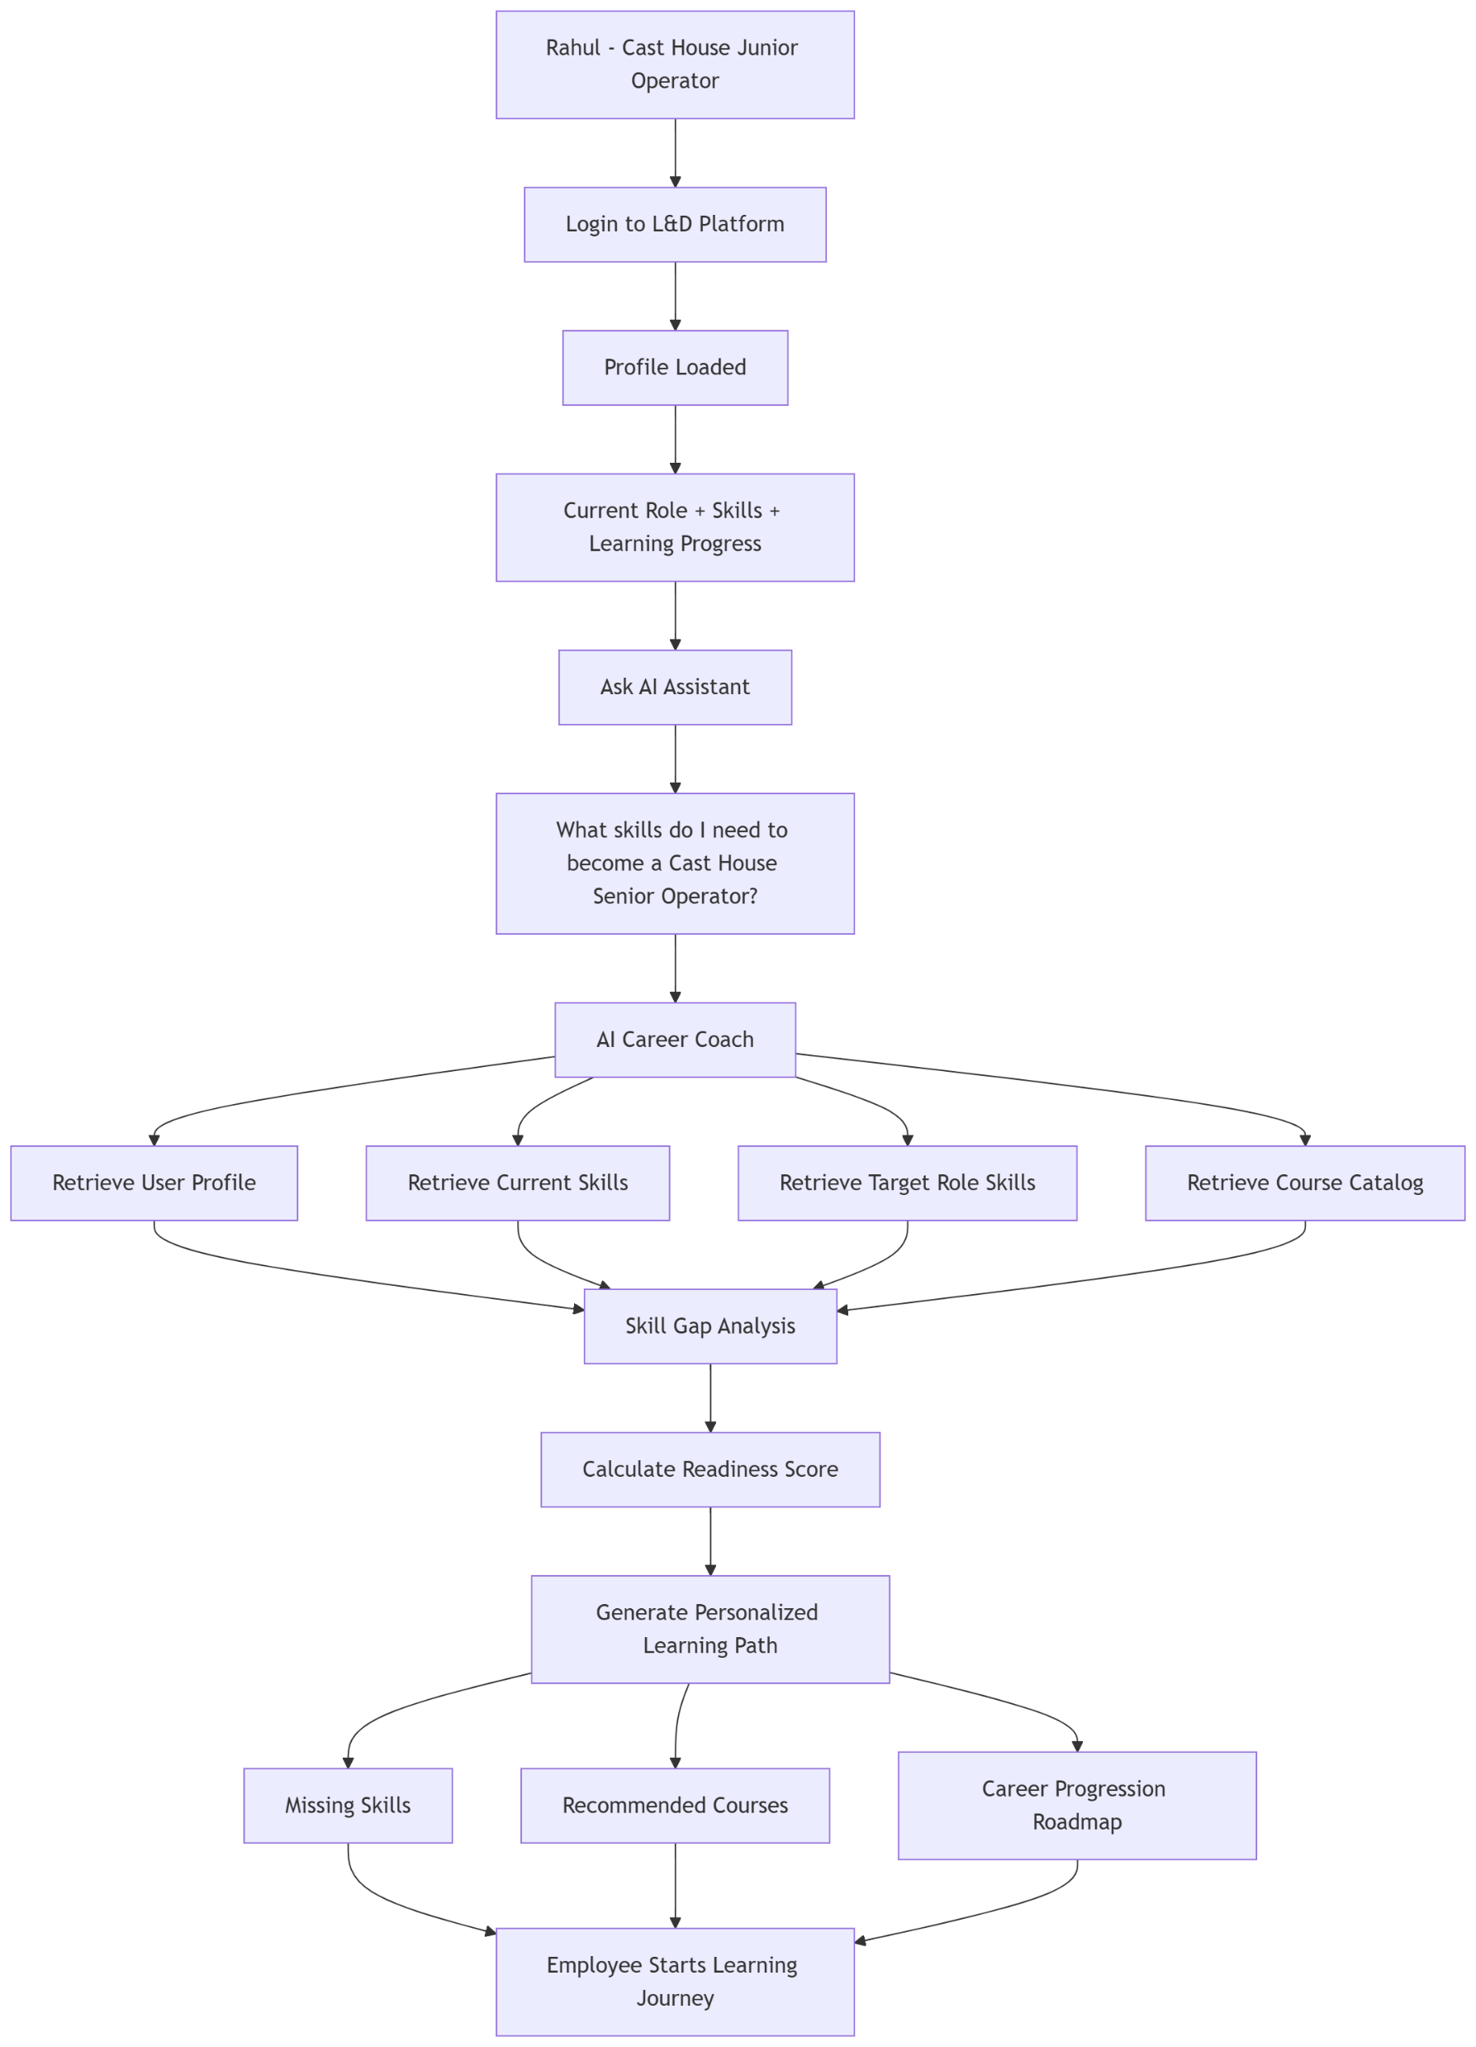
User Persona
Persona: Shopfloor Employee
Profile:
Works in plant operations or maintenance
Limited technical background
Uses mobile device or kiosk
Needs quick, simple answers
Pain Points:
Doesn't know next career step
Unsure which courses to take
Difficult to search large manuals
Training information spread across systems
Goals:
Learn required skills
Progress to next role
Find relevant training courses

Slide 7
Sample Prompt and Expected Output for Persona 1
Persona 1: Career Growth Employee
Sample Prompt Person: "I am currently a Cast House Junior Operator. What do I need to become a Cast House Senior Operator?“
Expected Output
Target Role: Cast House Senior Operator
Current Role: Cast House Junior Operator
Missing Skills:
Communication Related Skills
Problem Solving Attitude
High Concentration Levels
Operational Practice of Blast Furnace Stoves
Readiness Score: a score between 0-100 (based on experience + current skills)
Recommended Courses: Advanced Cast House Operations, Industrial Communication Skills,
Problem Solving & Root Cause Analysis
Suggested Learning Path: Complete the recommended courses and gain proficiency in the identified skill gaps to improve readiness for promotion.

Slide 8
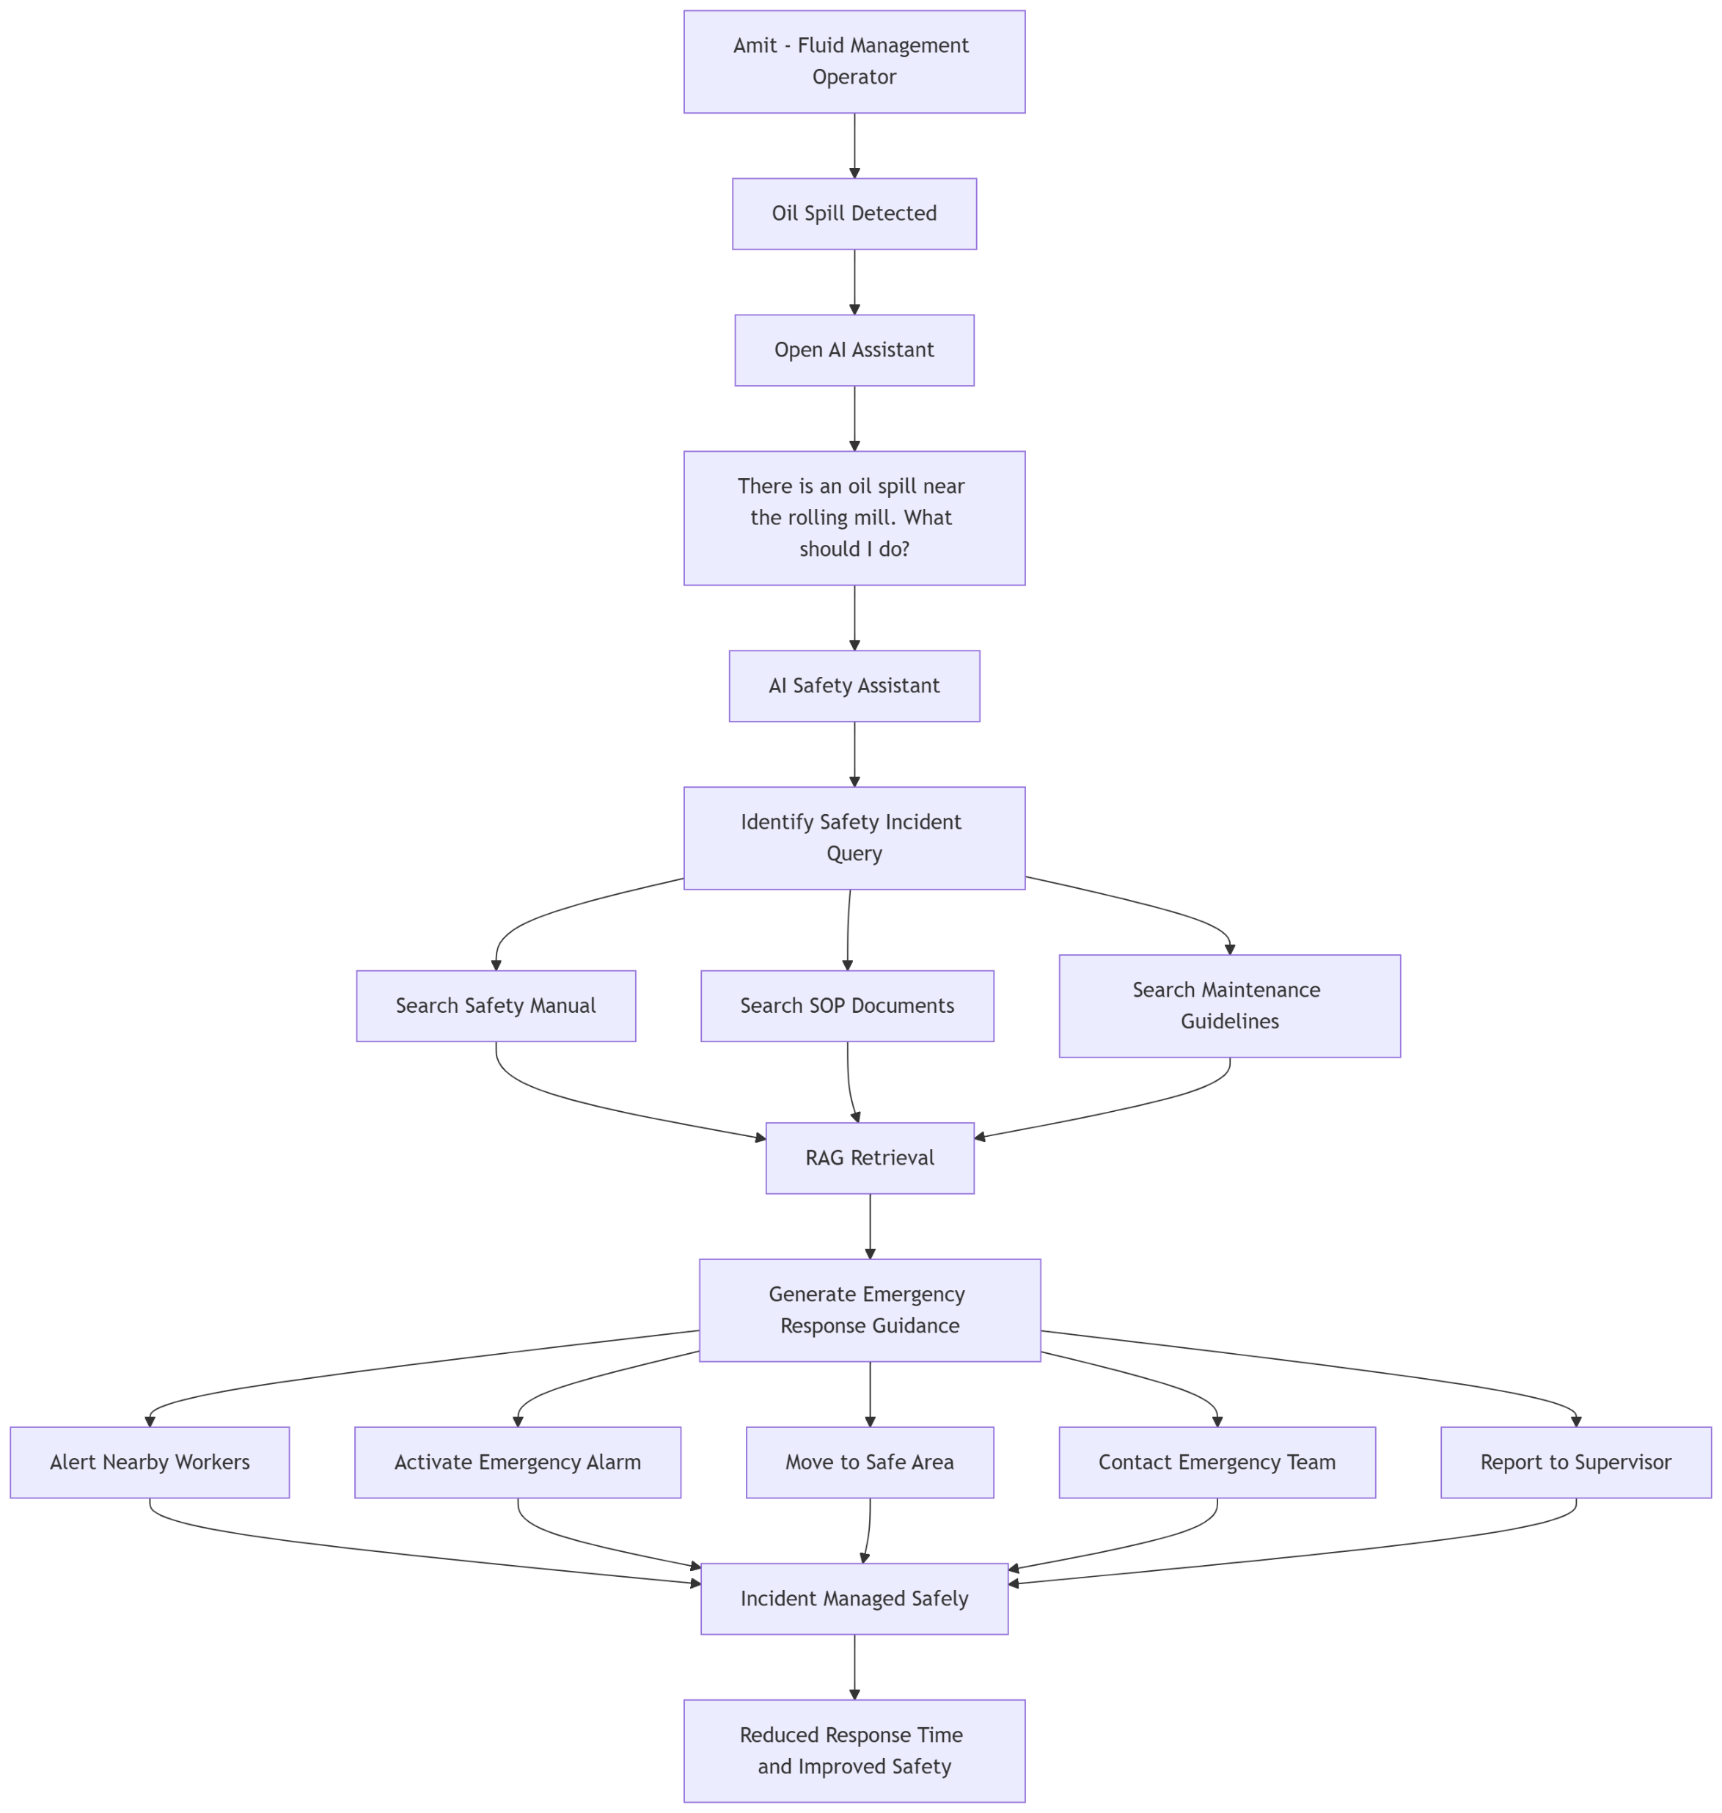
Persona 2: Shopfloor Worker Facing Oil Spill
Name: Amit Singh Role: Fluid Management Operator – Rolling Mills Experience: 4 Years Department: Operations
Goal
Amit wants to respond to the oil spill safely, protect nearby workers,
minimize operational risk, and follow the correct procedures.
Pain Points
Needs immediate guidance during a potentially hazardous situation.
May not remember the exact emergency response procedure under pressure.
Cannot spend time searching through lengthy safety manuals.
Needs accurate, step-by-step instructions to avoid safety violations.
Requires quick access to emergency contacts and escalation procedures.

Slide 9
Sample Prompt and Expected Output for Persona 2
Shopfloor Worker Facing Oil Spill
Prompt
Amit: "There is a hydraulic oil spill near the rolling mill. What should I do immediately?“
Expected Output
Immediate Safety Actions:
Alert nearby workers immediately.
Activate the emergency alarm.
Isolate the affected area.
Stop nearby equipment if it is safe to do so.
Do not attempt cleanup alone.
Contact the emergency response team.
Follow the approved spill containment procedure.
Report the incident to the supervisor with location and severity details.
Emergency Contact: 1800-TATA-SOS
Source Documents: Safety Manual, Maintenance SOP, Fluid Management Operator Guidelines

Slide 10
Impact
Employee Level:
* Faster access to knowledge
* Personalized learning recommendations
* Clear career progression visibility
Manager Level:
* Team skill-gap visibility
* Improved training monitoring
* Better workforce planning
L&D Level:
* Department-wide analytics
* Skill-gap identification
* Training effectiveness tracking
Expected Outcomes:
* Reduced time spent searching for information
* Increased training completion rates
* Improved workforce readiness
* Better alignment between training and role requirements
Why This Solution
This solution combines:
* AI Knowledge Assistant
* Skill Gap Analysis
* Personalized Learning Recommendations
* Career Progression Guidance
* L&D Analytics
All of the above into a single platform designed specifically for Tata Steel employees.
The system should be usable by shopfloor workers without requiring technical knowledge.

Slide 11
Expected Tech stack and data collection
Datasets Required For AI agent:
───────────────
Annual Report - From Tata Portal
Sustainability Report - From Tata Portal
NSDC PDFs (28 files) - For Details about Job roles and skillsets required
Safety Manual PDF -Standard Manuals
HR Policy PDF - Simulated or From Portal
Leave Policy PDF - Simulated or From Portal
Maintenance Manual PDF - Simulated or From Portal
Onboarding PDF - Simulated or From Portal
Tata Courses CSV - Made using NSDSC or Pre existing datasets
Equipment Sensor CSV - Simulated or From Kaggle
Production KPI CSV - Simulated or From Kaggle
Skills CSV - Simulated or From Kaggle
Data Layer and Auth
───────────────
SQLite
PyPDF
JWT Authentication
Frontend ───────────────
React.js
Vite
Tailwind CSS
Recharts
Axios
RAG Layer
───────────────
Chroma DB
Sentence Transformers
(paraphrase-multilingual-MiniLM-L12-v2)
To give user access to Hinglish conversations
AI Layer
───────────────
Groq (llama-3.1-8b-instant)
LangChain
Backend
───────────────
FastAPI
Uvicorn

